Slide 1
Statistics and Probability:
Naïve Bayes
Statistics and Probability
Bayes Theorem
Naïve Bayes Algorithm
Make Prediction
Implementation with Python

Slide 2
What is Naïve Bayes?
The Naive Bayes classifier separates data into different classes according to the Bayes’ Theorem, along with the assumption that all the predictors are independent of one another. It assumes that a particular feature in a class is not related to the presence of other features.

Slide 3
Naïve Bayes: Advantages
This algorithm works very fast and can easily predict the class of a test dataset.
You can use it to solve multi-class prediction problems as it’s quite useful with them.
Naive Bayes classifier performs better than other models with less training data if the assumption of independence of features holds.
If you have categorical input variables, the Naive Bayes algorithm performs exceptionally well in comparison to numerical variables.

Slide 4
Applications of Naive Bayes Algorithm
As you must’ve noticed, this algorithm offers plenty of advantages to its users. That’s why it has a lot of applications in various sectors too. Here are some applications of Naive Bayes algorithm:
As this algorithm is fast and efficient, you can use it to make real-time predictions.
This algorithm is popular for multi-class predictions. You can find the probability of multiple
target classes easily by using this algorithm.
Email services (like Gmail) use this algorithm to figure out whether an email is a spam or not. This algorithm is excellent for spam filtering.
Its assumption of feature independence, and its effectiveness in solving multi-class problems, makes it perfect for performing Sentiment Analysis. Sentiment Analysis refers to the identification of positive or negative sentiments of a target group (customers, audience, etc.)
Collaborative Filtering and the Naive Bayes algorithm work together to build recommendation systems. These systems use data mining and machine learning to predict if the user would like a particular resource or not.

Slide 5
Basic Probability

Slide 6

Bayes Theorem
Bayes’ Theorem is a simple mathematical formula used for calculating conditional probabilities.
Conditional probability is a measure of the probability of an event occurring given that another event has (by assumption, presumption, assertion, or evidence) occurred. The formula is: —
Probability of X occurring given evidence y has already occurred
Probability of y occurring
Probability of y occurring given evidence X has already occurred
Probability of X occurring

Slide 7

Bayes Theorem
Bayes’ Theorem is a simple mathematical formula used for calculating conditional probabilities.
Conditional probability is a measure of the probability of an event occurring given that another event has (by assumption, presumption, assertion, or evidence) occurred. The formula is: —

Slide 8

Bayes Theorem
Bayes’ Theorem is a simple mathematical formula used for calculating conditional probabilities.
Conditional probability is a measure of the probability of an event occurring given that another event has (by assumption, presumption, assertion, or evidence) occurred. The formula is: —

Slide 9
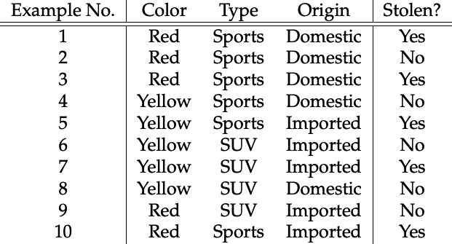
Naïve Bayes
Class

Slide 10
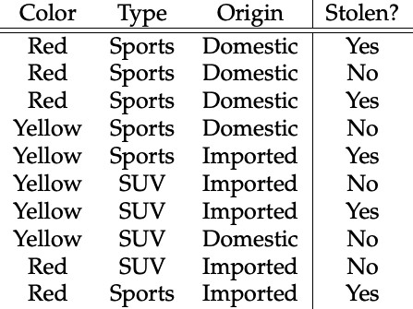
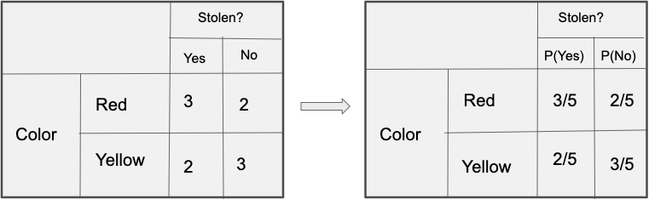
Naïve Bayes
Frequency Table
Likelihood Table

Slide 11
Naïve Bayes
Frequency Table
Likelihood Table
Color

Slide 12
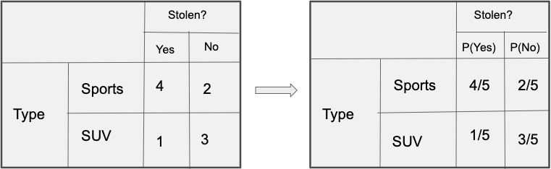
Naïve Bayes
Frequency Table
Likelihood Table
Type

Slide 13
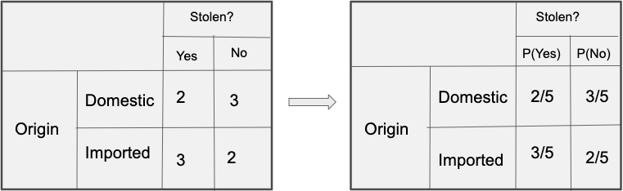
Naïve Bayes
Frequency Table
Likelihood Table
Origin

Slide 14

Naïve Bayes
?
Now, The Question is -

Slide 15
Bayes Theorem
Bayes’ Theorem is a simple mathematical formula used for calculating conditional probabilities.
Conditional probability is a measure of the probability of an event occurring given that another event has (by assumption, presumption, assertion, or evidence) occurred. The formula is: —

Slide 16
Naïve Bayes
As per the equations discussed above, we can calculate the posterior
probability P(Yes | X) as :
Now, The Question is -
= 3/5 * 1/5 * 2/5 * 0.5
= 0.0092

Slide 17
Naïve Bayes
As per the equations discussed above, we can calculate the posterior
probability P(Yes | X) as :
Now, The Question is -
= 3/5 * 1/5 * 2/5 * 0.5
= 0.0092
and, P(No | X):
= 2/5 * 3/5 * 3/5 * 0.5
= 0.072

Slide 18
Naïve Bayes
As per the equations discussed above, we can calculate the posterior
probability P(Yes | X) as :
Now, The Question is -
= 3/5 * 1/5 * 2/5 * 0.5
= 0.0092
and, P(No | X):
P(No) >> P(Yes)
Output: No
= 2/5 * 3/5 * 3/5 * 0.5
= 0.072

